Slide 1

Text Analysis of Aviation Safety Data
Predict 453 – Final Project Report
Rahul Sangole Mar 17 2018

Slide 2
Contents
Data Source
Approach
Input Data
Exploratory Data Analysis
Data Preprocessing
Modeling
TF-IDF
tSNE
Structural Topic Modeling
Lessons Learnt
References

Slide 3
Data Source
This is the dataset used for the SIAM 2007 Text Mining competition¹.
This competition focused on developing text mining algorithms for document classification.
The documents in question were aviation safety reports that documented one or more problems that occurred during certain flights.
The goal was to label the documents with respect to the types of problems that were described. This is a subset of the Aviation Safety Reporting System (ASRS) dataset, which is publicly available.
¹ https://c3.nasa.gov/dashlink/resources/138/

Slide 4
Approach
Explore the data
How can I use the labels / categories?
Text Preparation
Text Corpus (Xs)
Labels (Y)
Eliminate non-unique categories
Remove airport IATA codes
Strip whitespaces
Case to lower
Handle period separation
Remove punctuation
Remove too common words
Remove taxiway designations
Tidy Text
One row per “category + dsid + word + count”
TF-IDF calculations upon category
tSNE investigation into underlying structures of term-document-matrix
How many structures show up? These could indicate # of topics
Structural Topic Models
Use tSNE to identify # of topic models
Specify # of topic models
Post process STM models
Interpret the model results
Plots
Quantitative results
Text Preparation
Remove stopwords
Identify non-unique categories
What level of aggregation should I consider my DSIDs?

Slide 5
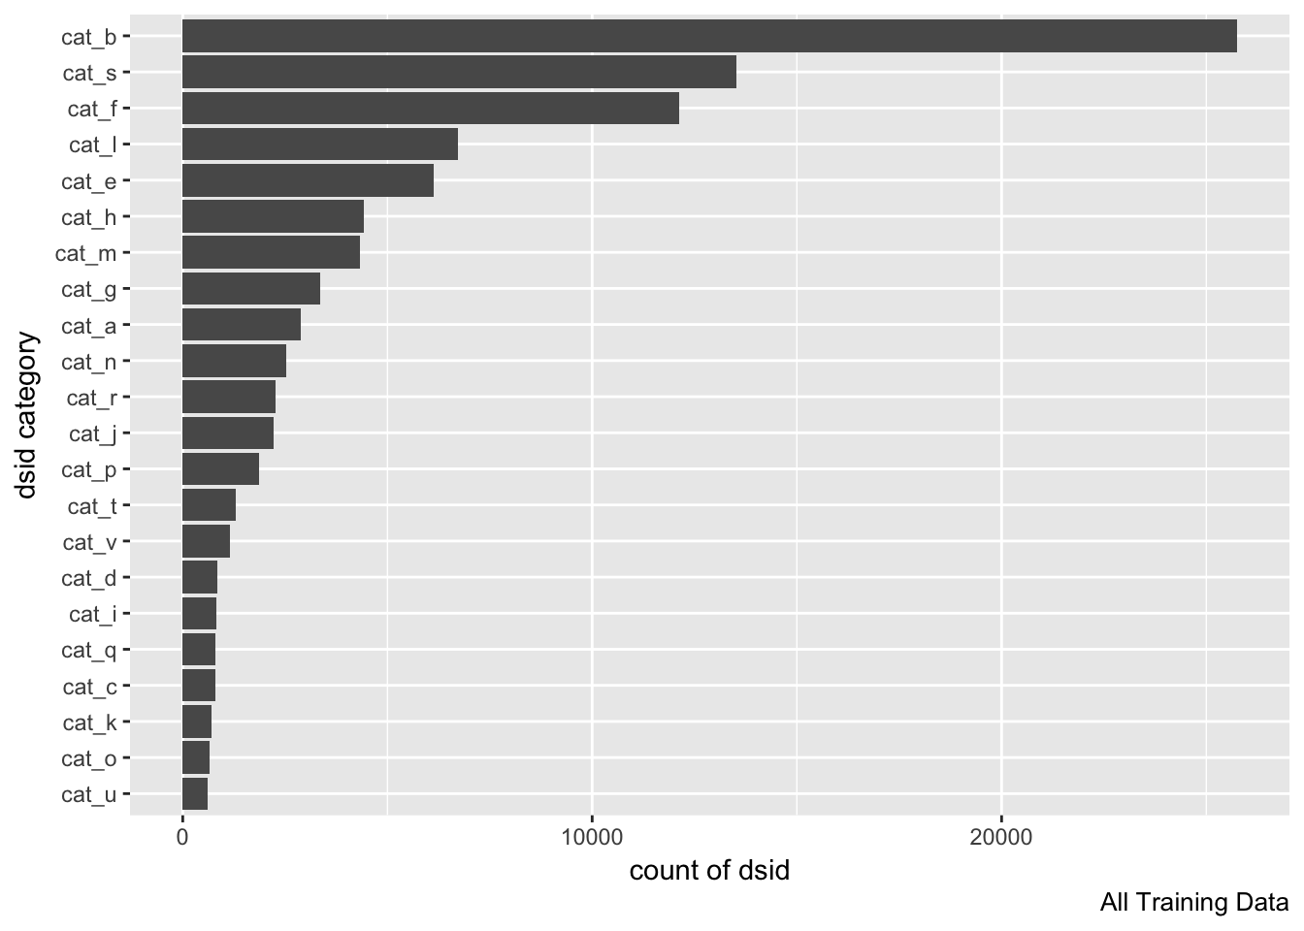
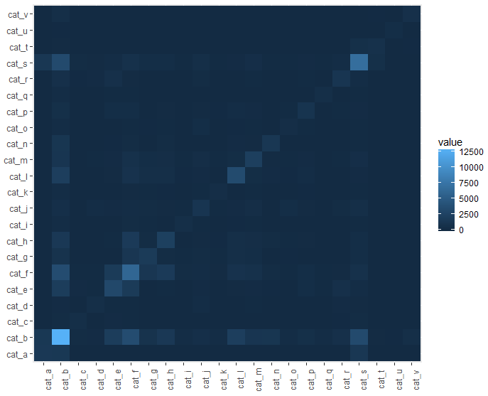
Input Data
This is a very large dataset: [21519, 24]
Each of the 21519 DSI is an aviation safety report
There are a total of 22 categories. The categories aren’t labeled. Does each category correspond to a topic? Or are there multiple topics within each category?
Each DSID can belong to more than 1 category. [If this was false, all off diagonal cells would be dark].

Slide 6
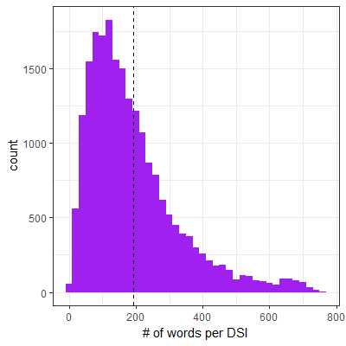
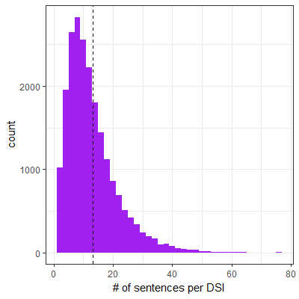
Exploratory Data Analysis
Interesting artifacts
“pass flightlevel climb TO flightlevel RUDDER RATIO AND AILERON LOCKOUT engineindicationandcrewalertingsystemmessage occur.near LEVELOFF captain south ALTIMETER fail AND UNWOUND TO _ feet.WE level OFF us firstofficer south ALTIMETER AFTER A deviate OF _ feet.left centralairdatacomputer HAD fail”
There is a mixture of lowercase and UPPERCASE words
Some lowercase words seem to be pre-processed tokens (bi / tri grams)
Sentences are separated by a period with no adjacent spaces
Numbers have been replaced by _
Stemming seems to have been done
Airport IATA codes show up in lowercase
“ON taxiout AT bos airport I miss A TURN AND CAME INTO CONFLICT WITH AN aircraft _.WE BOTH CAME TO A STOP AND I realize MY MISTAKE.THERE WAS NEVER ani DANGER OF hit EACH OTHER.I WASWAY.humanfactor give OTHER taxiinstruction BY ground AND WENT ON MY DURING taxiout THE firstofficer IS frequent OUT OF THE LOOP get LOAD DATA AND takeoff perform.BOTH set OF eye ARE need DURING TAXI.AFTER EVENT OF _ IT HAS BEEN hard TO FOCUS AND CONCENTRATE.firstofficer south HAVE TOLD ME THIS ALSO.WE NOW MORE THAN EVER FORCE OURSELVES TO BE mind OF THE TASK AT HAND.”

Slide 7
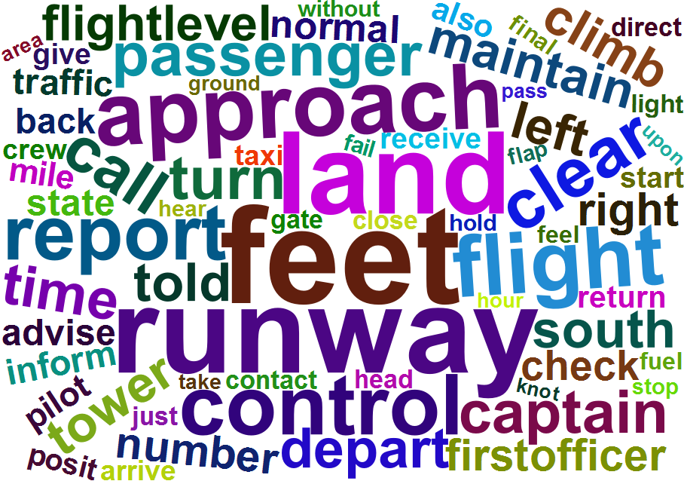
Word Cloud

Slide 8
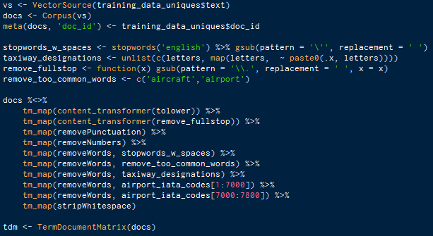
Data Processing
Remove non-unique categories
Handle period separation
Remove punctuation
Remove stopwords
Remove too common words
Remove taxiway designations
Remove airport IATA codes
Strip whitespaces
Case to lower
approximate _ ON september _ captain call ask WHERE hi CLOSEOUT WAS.THE loadagent work THE flight inform ME THAT THE FINAL CARGO number WERE NOT enter YET AND THERE WAS A CHANCE THE flight MIGHT BE OVER THE maximum RAMP weigh.WHEN THE FINAL CARGO number WERE final receive BY THE loadagent SHE BECAME suspicion AS TO THE FIGURE…
approximate september captain call closeout loadagent work flight inform final cargo number enter yet chance flight might maximum ramp weigh final cargo number final receive loadagent became suspicion figure…

Slide 9
Modeling
Modeling Approaches
TF-IDF Based
STM Based
tSNE Based
Using existing known categories and TF-IDF, can we identify patterns in the categories?
Using only the term-document-matrix, can we identify any patterns? How many topics exist in the corpus?
Using only the term-document-matrix, can we identify topics in the corpus? How many topics? What are the topics? How do they agree with the known categories?

Slide 10
How I’m defining a DSI
For TF-IDF Analysis
All the individual safety reports are grouped into the 22 known categories
Thus, this is equivalent to a total of 22 DSIs in the corpus, each containing thousands of sentences
For STM Analysis
Started with the TF-IDF approach
Switched to defining each safety report as it’s own DSI
Thus, total DSIs = 5949

Slide 11
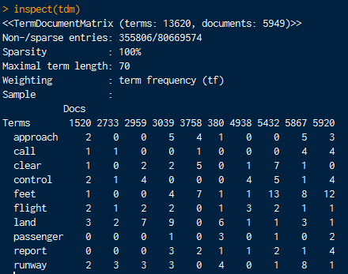
Equivalence Classes, Reference Term Vectors, Document Term Matrix
Manually read through 10s of safety reports
I could not find any obvious terms which I would group together into ECs
The RTV is thus the remainder of the terms after pre-processing
tidytext is used to create the RTV which is fed into a TermDocumentMatrix generation function
The definition of ‘documents’ depends on if I’m doing a TF-IDF or STM

Slide 12
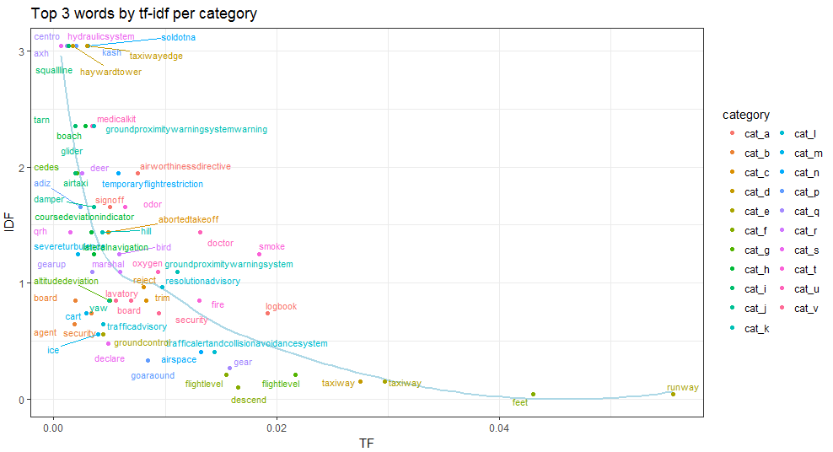
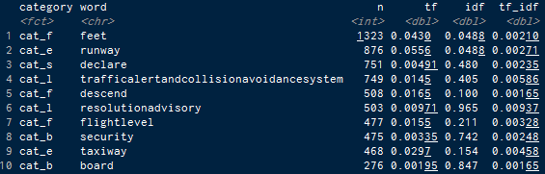
TF-IDF Based Analysis
Some terms are very exclusive to certain categories, with high values of IDF and low values of TF. Ex: hydraulicsystem for cat_s
Others terms like runway show up in a lot more documents, yet have high TF values for certain categories like cat_d
Both these instances result in high TF-IDF values within the respective categories

Slide 13
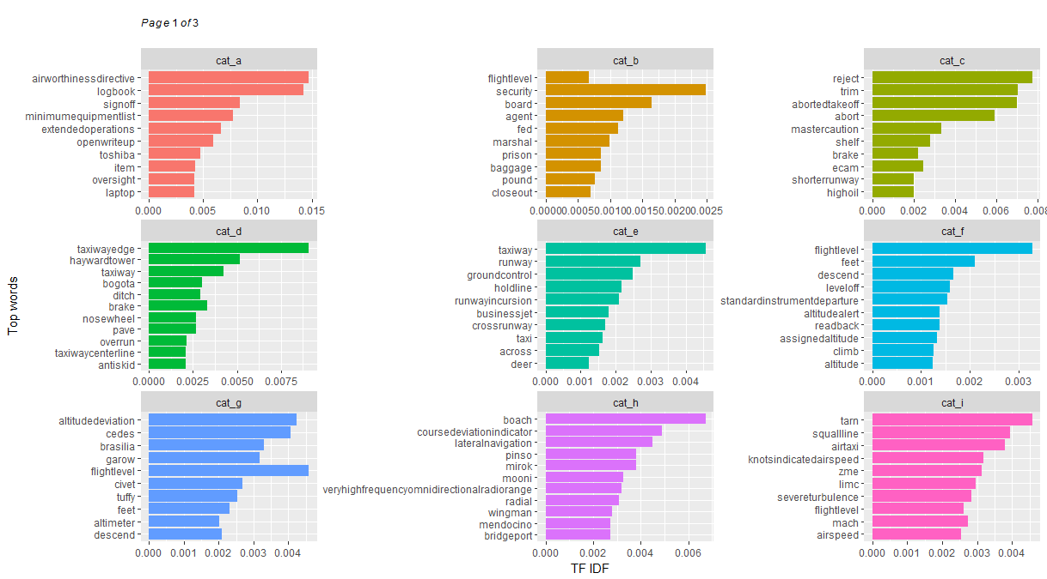
TF-IDF Based Analysis
Rejected, aborted take-offs
On board security issues
On ground violations
Altitude related issues
¹ Remainder of the plots in the appendix

Slide 14
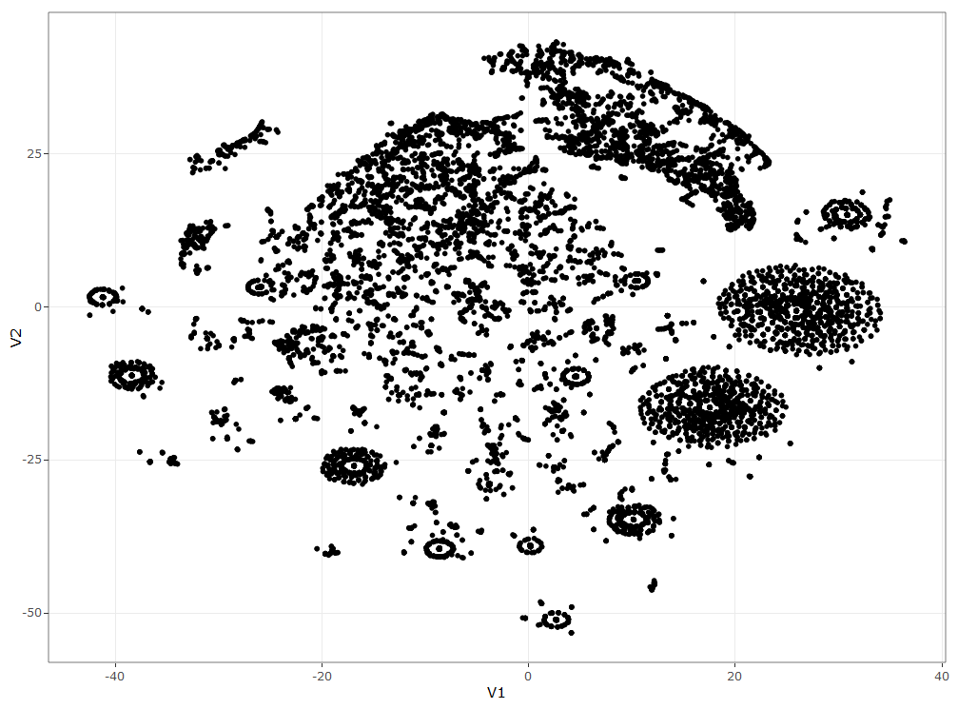
Structural Investigation using tSNE
handcuff, police…
Names of mechanical components
tSNE analysis is performed on the Euclidian distance matrix between the words in the final term-document-matrix
The Rtsne package offers significant compute efficiency vs the tsne package
We can see very clear clusters in the data, which may point to topics in the corpus
Investigation of these points manually using plotly reveals patterns which can be interpreted
Dizzy, kidney, bloody, revive…
doppler radar, turbulence, contingency fuel, thunder storm cell
Ground control related
flippant, passive, difficulty understanding, sarcastic, verbatim...

Slide 15
Structural Topic Modeling
STMs allow researchers to flexibly estimate a topic model
STMs are like LDA models, except they extend the capability to include document-level metadata into the topic model. This allows researchers to not only estimate topics but also relationships to document metadata.
The stm package in R is quite powerful with many features which work well with the tidyverse, tm, quanteda and other major R packages
Using stm, there are two main approaches towards deciding how many topics (K) are contained in the corpus:
Define the value(s) of K yourself
Use tsne to perform a dimension reduction on the TDM followed by some geometric calculations to estimate the number of “groupings”
This method resulted in 116 topics!
To begin with, I’m assuming K=10

Slide 16
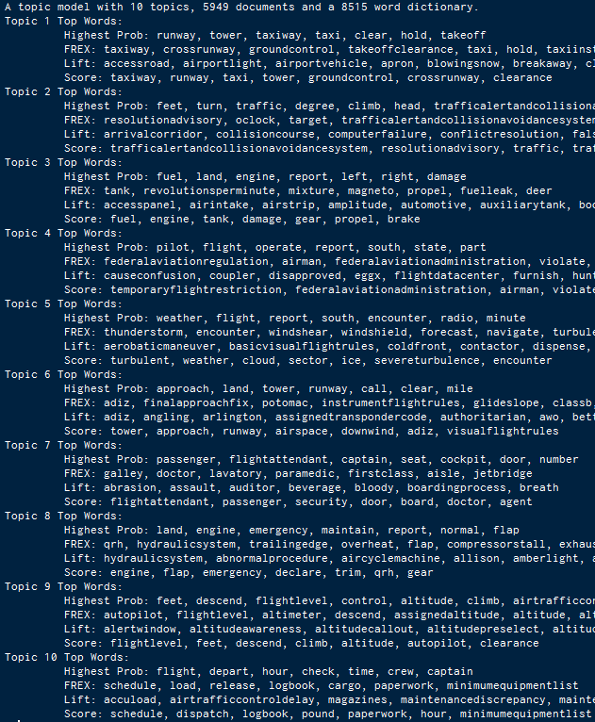
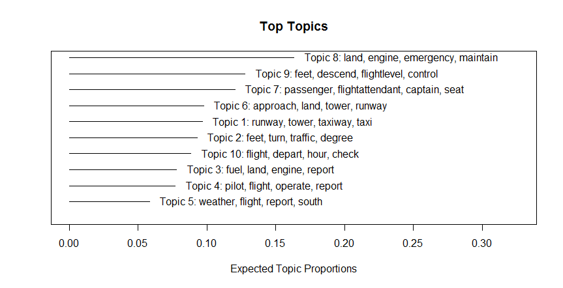
STM Results, K=10
For each topic,
Highest probability terms
FREX: How exclusive terms are to this topic?
Lift: Higher weight to words which appear less frequently in other topics

Slide 17
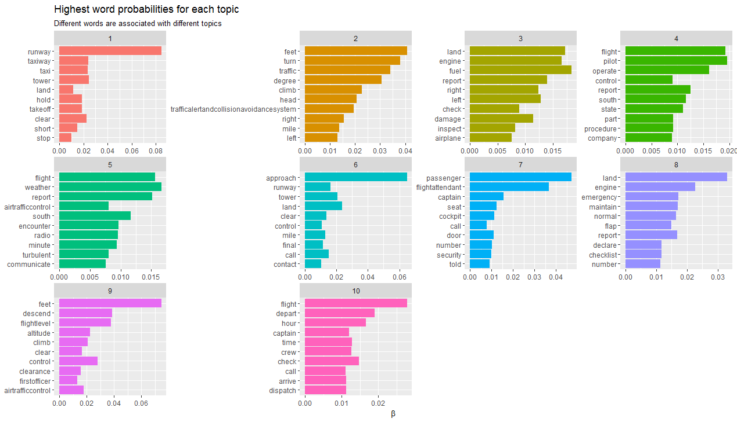
Word Probabilities Per Topic
On ground violations
Weather related issues
On board security issues
Altitude related issues

Slide 18
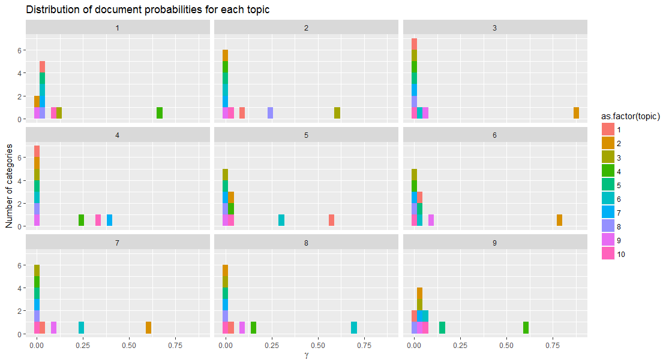
Document Distribution among Topics
Each document should have a high gamma score for only one topic
¹ Showing 9 of 5949 DSIs

Slide 19
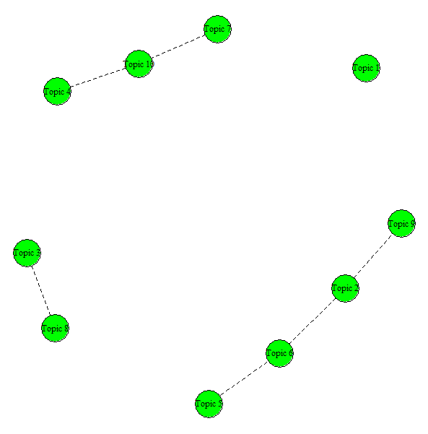
Topic Model Correlation
Some topics are closer together, others seem further apart
For example:
Topic 8 and Topic 3 both refer to engine and damage. While Topic 8 references hydraulic systems and flaps, Topic 3 references fuel & fuel leaks
Topic 1 is quite different from all the rest – it speaks about runway / taxiway / ground control clearance issues
We can model this using ‘topic correlations’. Positive correlations indicates that both topics are likely to be discussed in a document.

Slide 20
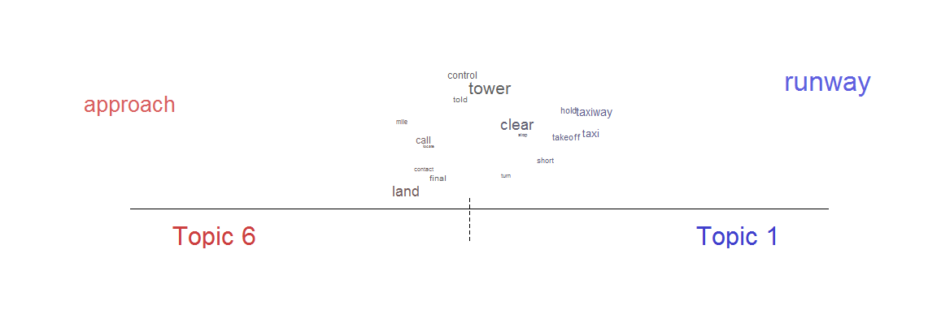
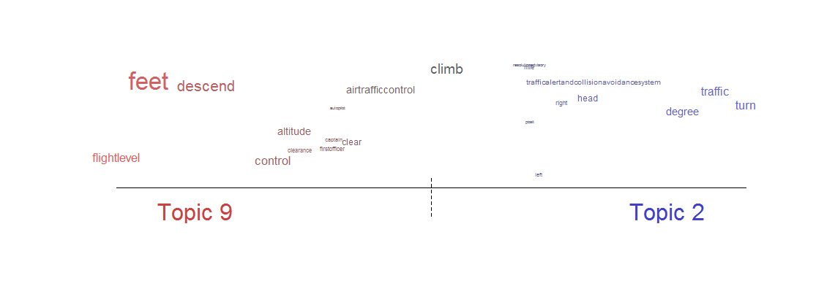
Topic Model Correlation

Slide 21
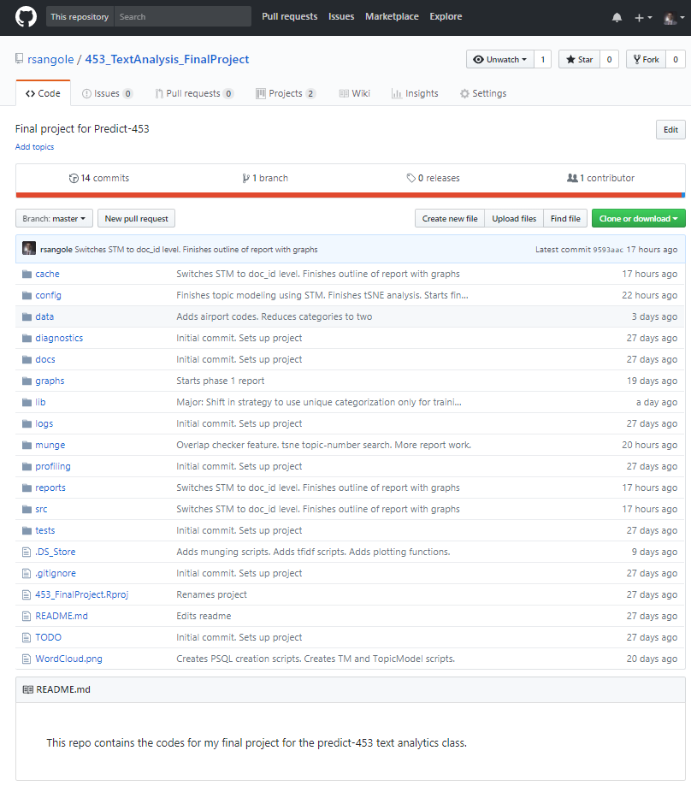
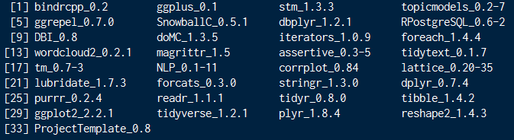
Codebase
https://github.com/rsangole/453_TextAnalysis_FinalProject

Slide 22
Lessons Learnt
Text analytics is a deep subject with many rabbit holes to get lost in
It’s a nascent field with a large number of analytics packages in R developed within the last 5 years
More non-quantitative work involved than any other course
Stability of results seem asymptotic and sensitive to pre-processing
Long way to go

Slide 23
References
Cfss.uchicago.edu. (2018). Text analysis: fundamentals and sentiment analysis. [online] Available at: http://cfss.uchicago.edu/fall2016/text01.html [Accessed 18 Mar. 2018].
Graham, T. (2018). Topic Modeling of Tweets in R: A Tutorial and Methodology. [online] Academia.edu. Available at: https://www.academia.edu/19255535/Topic_Modeling_of_Tweets_in_R_A_Tutorial_and_Methodology [Accessed 18 Mar. 2018].
Jockers, M. (2018). » The LDA Buffet is Now Open; or, Latent Dirichlet Allocation for English Majors Matthew L. Jockers. [online] Matthewjockers.net. Available at: http://www.matthewjockers.net/2011/09/29/the-lda-buffet-is-now-open-or-latent-dirichlet-allocation-for-english-majors/ [Accessed 18 Mar. 2018].
Juliasilge.com. (2018). Julia Silge - The game is afoot! Topic modeling of Sherlock Holmes stories. [online] Available at: https://juliasilge.com/blog/sherlock-holmes-stm/ [Accessed 18 Mar. 2018].
Krijthe, J. (2018). T-Distributed Stochastic Neighbor Embedding using a Barnes-HutImplementation [R package Rtsne version 0.13]. [online] Cran.r-project.org. Available at: https://cran.r-project.org/web/packages/Rtsne/index.html [Accessed 18 Mar. 2018].
Laurens van der Maaten. (2018). t-SNE. [online] Available at: https://lvdmaaten.github.io/tsne/ [Accessed 18 Mar. 2018].
Mcburton.net. (2018). Topic Modeling for JDH. [online] Available at: http://mcburton.net/blog/joy-of-tm/ [Accessed 18 Mar. 2018].
Robinson, J. (2018). Text Mining with R. [online] Tidytextmining.com. Available at: https://www.tidytextmining.com/ [Accessed 18 Mar. 2018].
STM vignette. (2018). [online] Available at: https://cran.r-project.org/web/packages/stm/vignettes/stmVignette.pdf [Accessed 18 Mar. 2018].
tm package. (2018). [online] Available at: https://cran.r-project.org/web/packages/tm/vignettes/tm.pdf [Accessed 18 Mar. 2018].
Weingart, S. (2018). Topic Modeling for Humanists: A Guided Tour – the scottbot irregular. [online] Scottbot.net. Available at: http://www.scottbot.net/HIAL/index.html@p=19113.html [Accessed 18 Mar. 2018].

Slide 24
Appendix

Slide 25
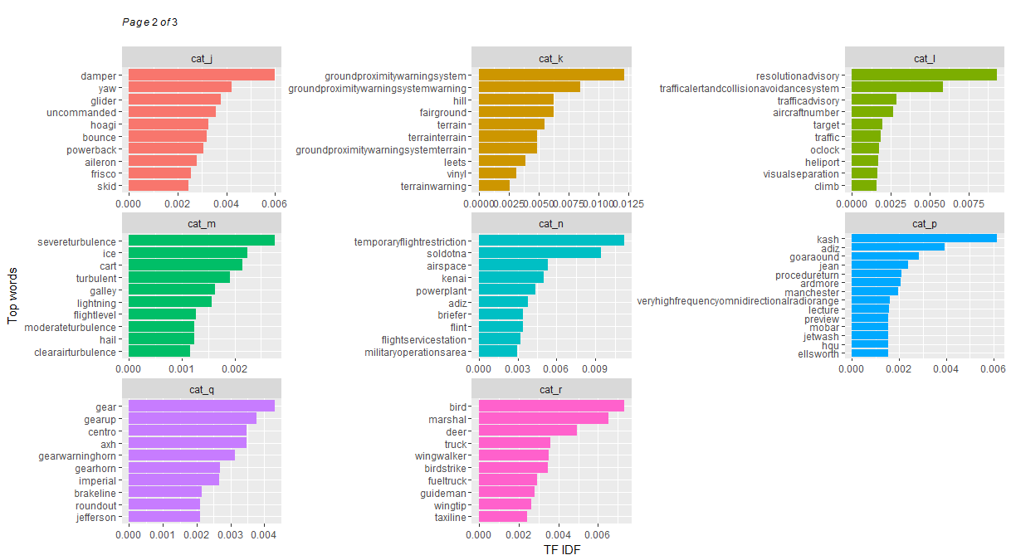
TF-IDF Based Analysis

